Slide 1

IBM SkillsBuild for Adult Learners - Data Analytics
Data Analytics Internship Program 2024 Final Project Presentation
Project Name : Lung Cancer Detection
Unique ID : IBM2364
Team Name :Hash Byte
College Name: Lokmanya Tilak College Of Engineering

Slide 2
Team Member
01
Balram Panigrahi
02
Team Leader
03
Gopinath Ghewade
Girish Patil
Team Member
Team Member
04
05
Lakshmi Rai
Mansi Kodag
Team Member
Team Member
06
07
Supriya Narkhede
Apoorva Rajput
Team Member
Team Member

Slide 3
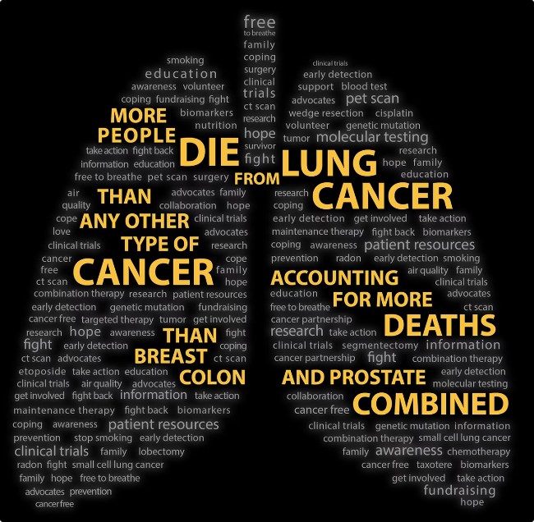
01
Introduction
Lung cancer is a leading cause of cancer-related deaths, making early detection vital for improving survival rates. Traditional diagnostic methods, while effective, can sometimes miss early-stage cancers, prompting the need for innovative approaches. Machine learning (ML) has emerged as a powerful tool in enhancing the diagnosis of lung cancer.

Slide 4
Objective Of Project
1
1
To collect and analyze health data from users and existing datasets
2
To identify key risk factors for lung cancer and their correlations.
3
To develop a machine learning model for predicting lung cancer risk
4
To validate and test the model using appropriate metrics.
5
To provide actionable recommendations for reducing lung cancer risk based on the analysis.

Slide 5

PROBLEM STATEMENT
High false-negative rates in current diagnostic methods.
Variability in image interpretation among radiologists.
Limited access to large, annotated datasets for training models.
Ensuring the model's interpretability to aid clinical decision-making.

Slide 6
Significance Of Problem
High Mortality Rate:
Resource Optimization:
Personalized Medicine
Limitations of Current Methods

Slide 7
Data Collection
01
02
03
Data Source
Data Description
Data Collection Methods
Medical Imaging Databases
Genomic and Clinical Data:
Clinical Databases
Medical Imaging: CT scans, X-rays with tumor annotations
GenomicData: Genetic mutations and expression profiles.
Public Datasets
Retrospective Studies
Clinical Trials
Crowdsourced Data
Real-time Acquisition:

Slide 8
Data Pre-Processing
Data Cleaning Method
Handling Missing Values
Remove Duplicates: Eliminate duplicate records.
Standardize Formats: Ensure consistency in data presentation
3.Outlier Detection: Identify and manage outliers using Z-scores or IQR.
Deletion: Remove rows with a small percentage of missing values.
2.Imputation: Replace missing values with mean, median, mode, or predictive models.
3.Flagging: Create binary flags for missing data.

Slide 9
Data Transformation Techniques
02
03
04
01
Normalization
Encoding Categorical Variables
Feature Engineering
Dimensionality Reduction
Scale numerical features to improve model performance.
Convert categorical data into numerical format using one-hot or label encoding.
Create new features from existing data for better insights.
Use methods like PCA to simplify data and reduce overfitting.

Slide 10
Data Analysis
Analytical Tools
R, Python, SQL
01
02
Methods
Regression Analysis, Machine Learning algorithms, Statistical Testing
03
Key Findings
Identification of significant predictors such as smoking frequency and environmental exposure.
Insights Derived
Development of a predictive model to assess individual risk and tailor screening recommendations
04

Slide 11
Hypothesis Development
Hypothesis
Rationale
Method for Testing
Machine learning algorithms, especially convolutional neural networks (CNNs), can accurately detect lung cancer in medical imaging with high sensitivity and specificity.
Advancements in Technology
Data Availability
Feature Extraction
Clinical Importance
Data Collection
Preprocessing
Model Selection
Training the Mode
Statistical Testing
Deployment

Slide 12
Solution Design
Implementation Plan
Proposed Solution
1
Develop a machine learning tool, primarily using Convolutional Neural Networks (CNNs), to analyze medical imaging (CT scans and X-rays) for early lung cancer detection.
Data Acquisition & Preprocessing
2
Model Development:
3
Model Evaluation
4
Deployment

Slide 13
Alignment with Sustainable Development Goals (SDGs)
SDG 3
SDG 9
SDG 10
SDG 17
Enhances health outcomes through early diagnosis.
Promotes innovation in the healthcare sector.
Reduces health disparities by improving access to diagnostics.
Encourages partnerships for data sharing and development.
01
02
03
04

Slide 14
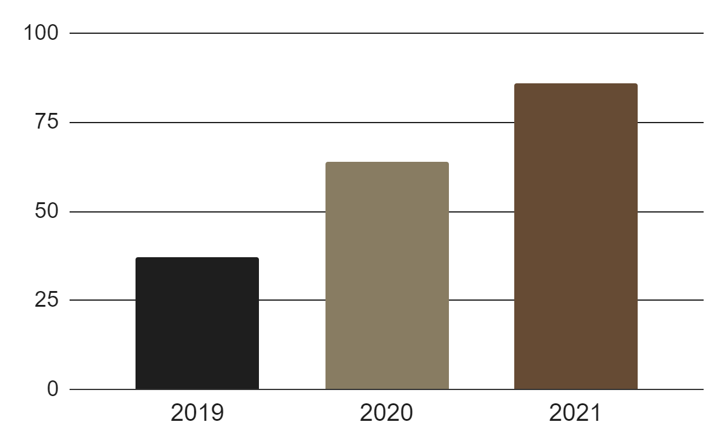
Data Visualization Techniques
Box Plots
Geospatial Maps
Displays feature distribution (e.g., tumor sizes) across classes
Illustrates lung cancer incidence by region.
Line Graphs:
Bar Charts
Shows predictive importance of different features.
Tracks model performance metrics over time.

Slide 15
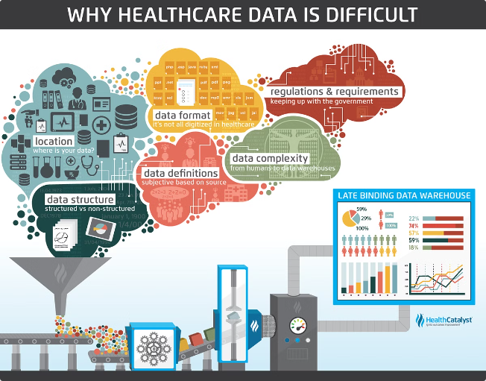
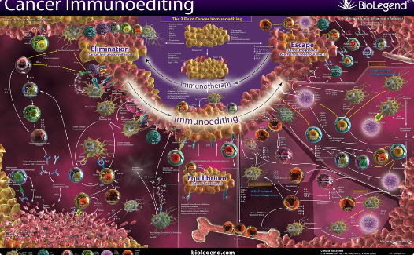
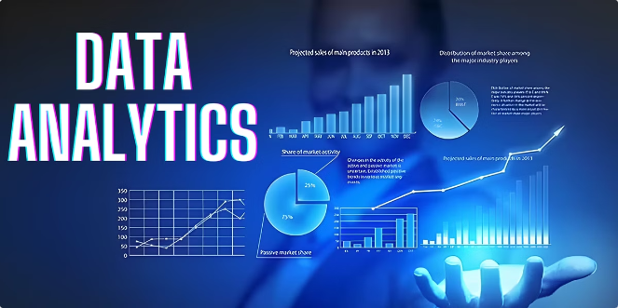
Conclusion
Impact of Proposed Solution
Cost Efficiency: Automation reduces manual review time and resources.
Timely Diagnosis: Early detection leads to better treatment outcomes.
Summary of Findings
Future Work
Enhanced Accuracy : Machine learning models improve lung cancer detection
Algorithm Variability:Different algorithms show varying performance, emphasizing proper model choice.
Diverse Data: Expanding datasets for better model generalizability.
Clinical Integration: Creating tools for easier implementation in clinical settings.

